Slide 1

Web Programming
By Alex Joslin

Slide 2
Telecommunications
Fields Of Computer Science
Data science
Cloud
Bioinformatics
Mobile
Networking
Web
DevOps
OS
Embedded
Cyber Security
AI & Machine Learning
Quantum Computing
IOT
Game

Slide 3



















Many Ways to Make a Website
Website Builders
By Scratch
Frameworks

Slide 4
The Basics of Web Programming
HTML
HyperText Markup Language
CSS
Cascading Style Sheets
Java Script

Slide 5
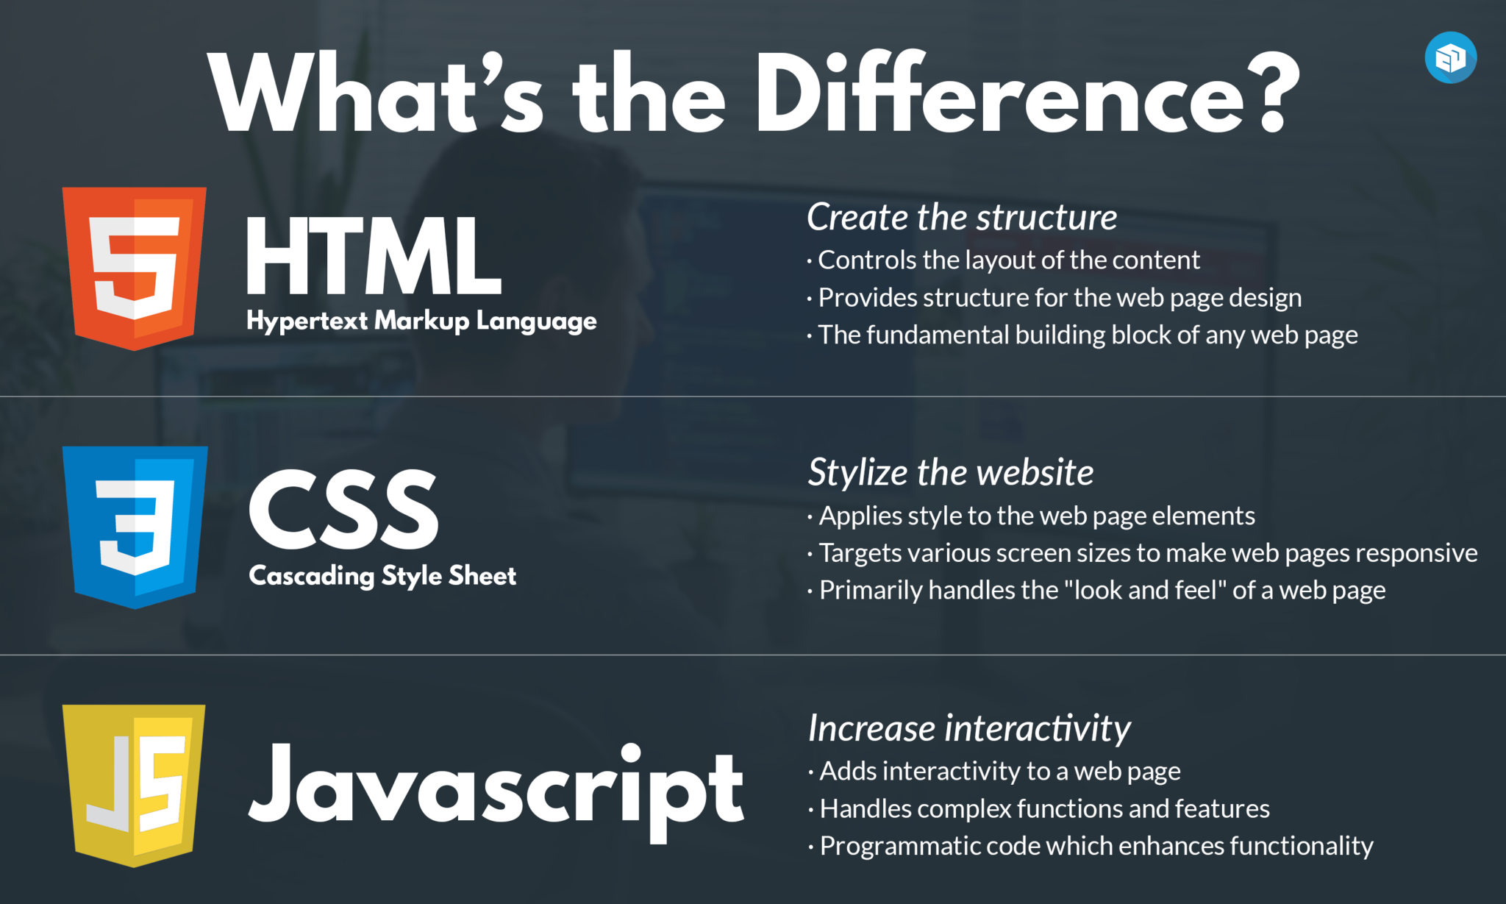

Slide 6
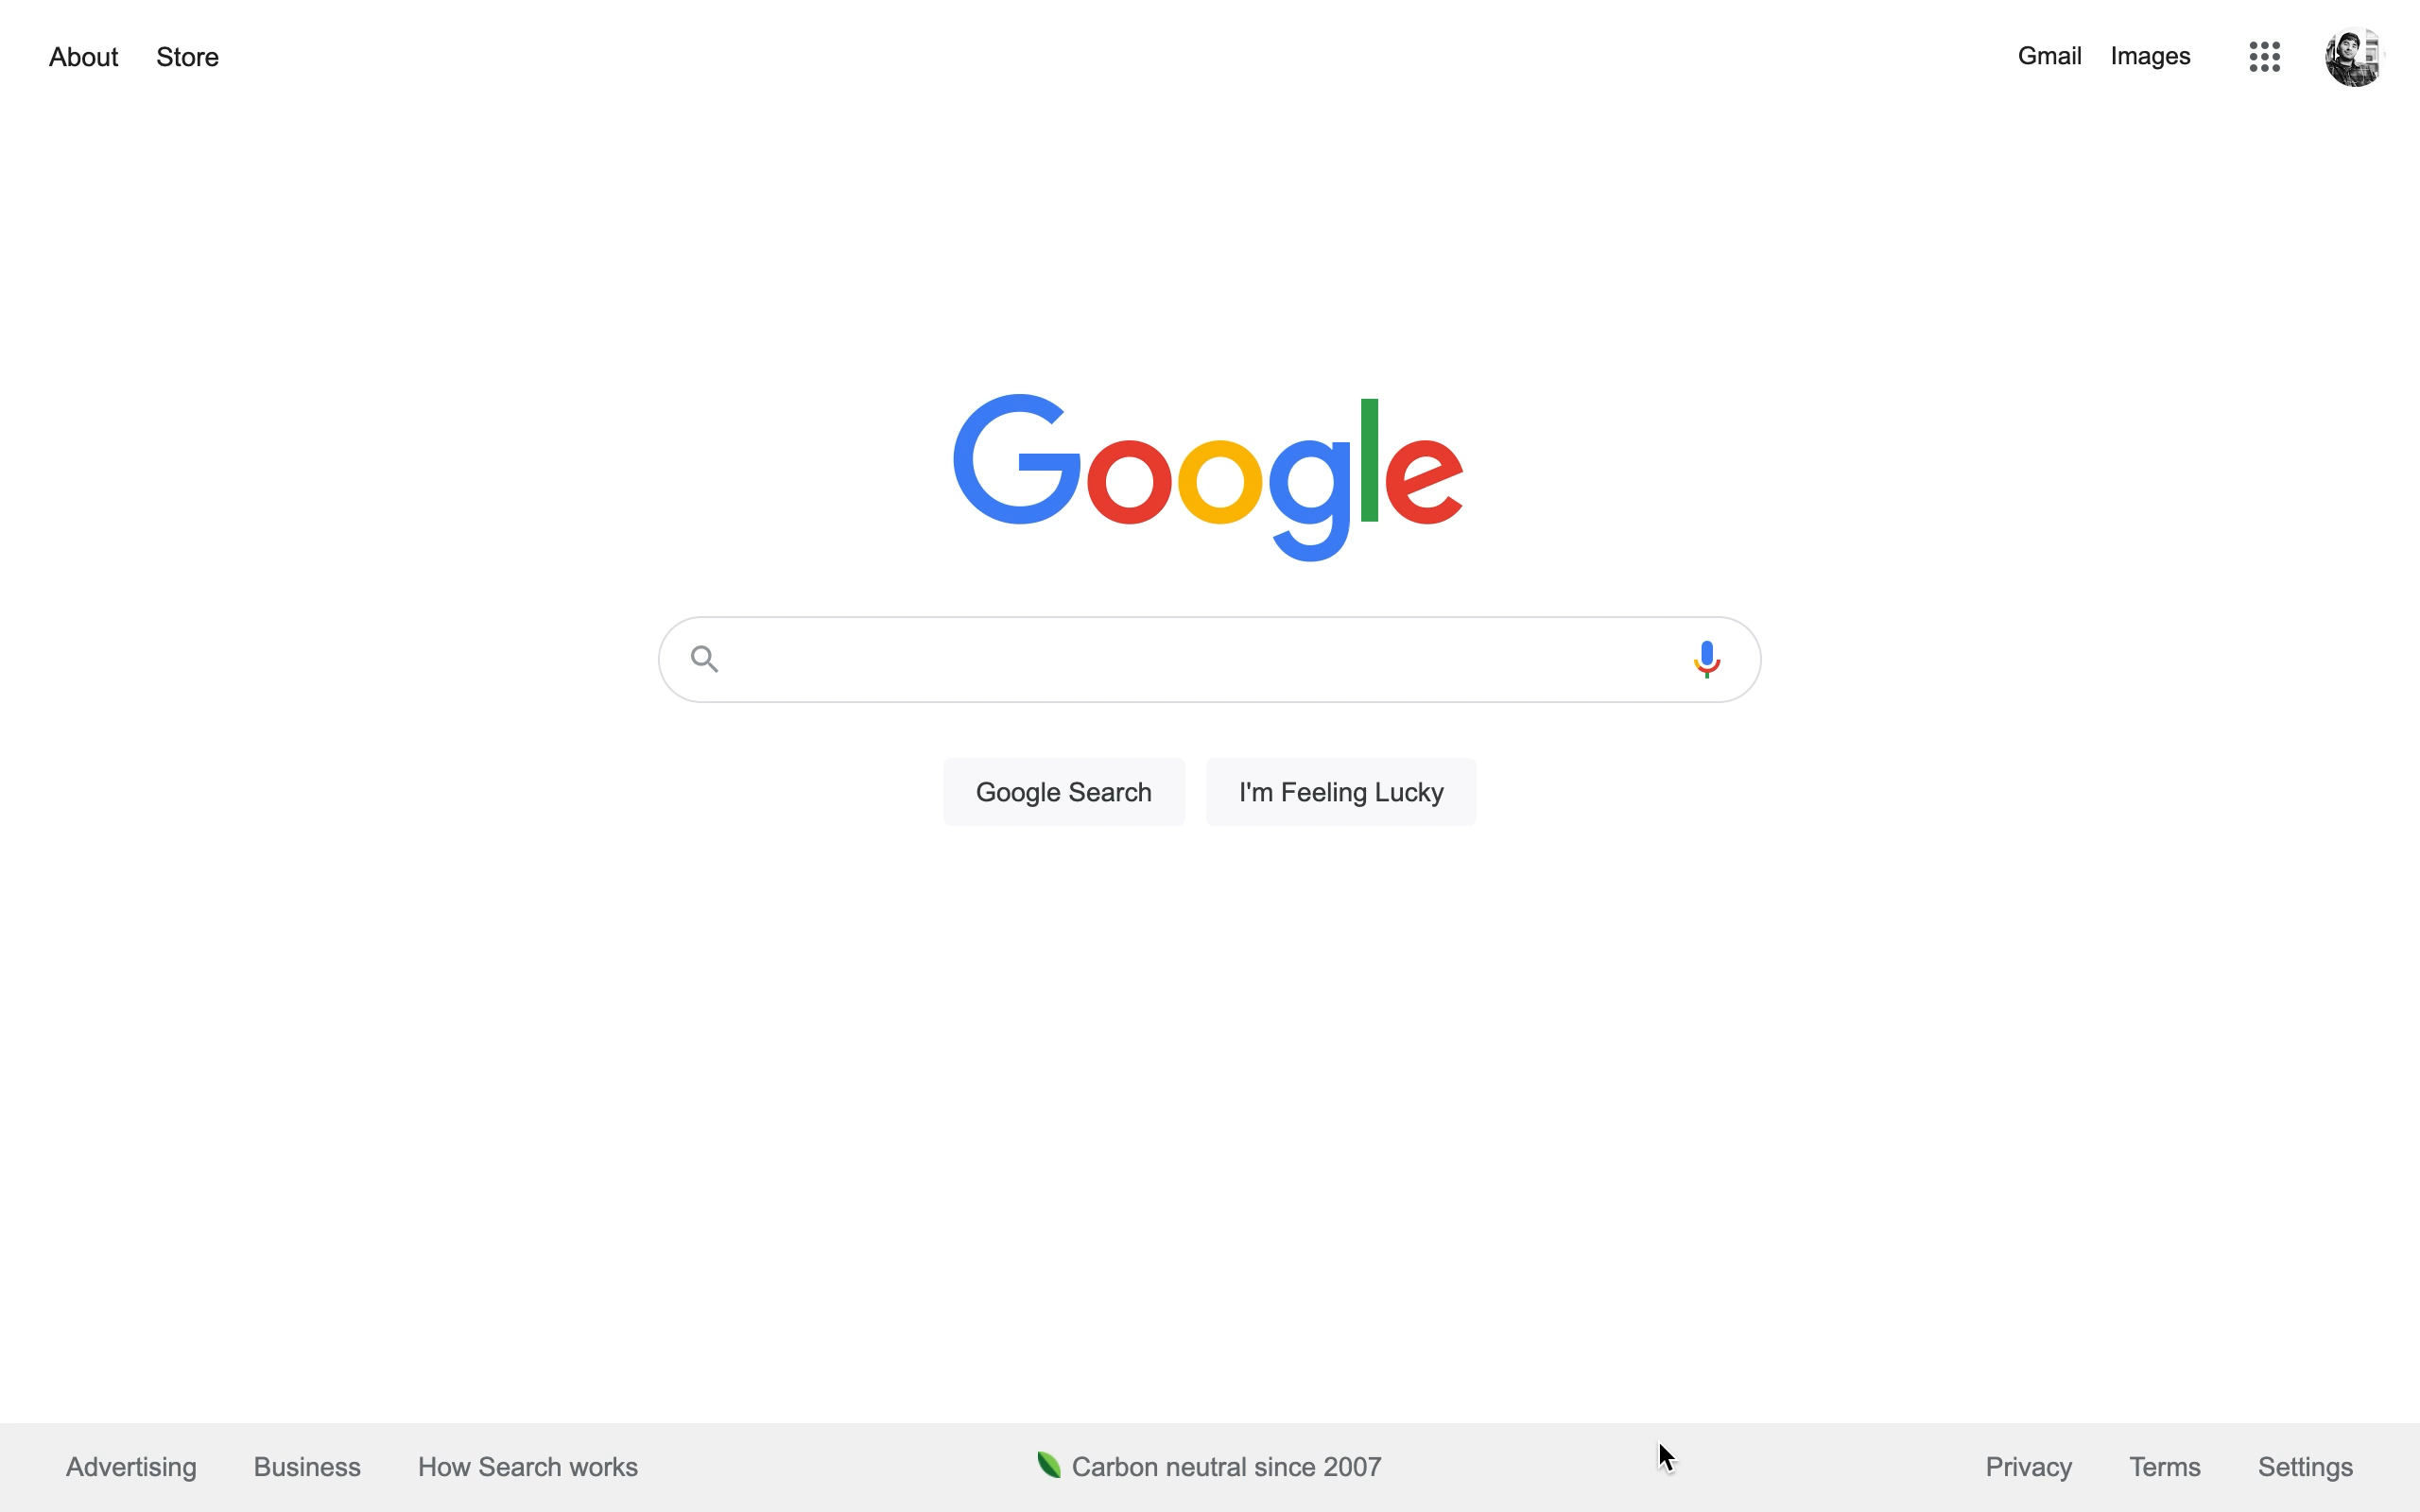
HTML
CSS
JavaScript

Slide 7
Other languages used in web programming
PHP
Ruby
TypeScript
Kotlin
Dart
Scala
SQL
Java
Python
C#

